Slide 1

Predictive Analysis

Slide 2
Objectives
Predictive Analysis Overview.
Standardize the data.
Split the data into training testing data.
Train different classification models.
Hyperparameter grid search.
Predictive Analysis

Slide 3
Predictive Analysis Overview
Space X advertises Falcon 9 rocket launches on its website with a cost of 62 million dollars; other providers cost upward of 165 million dollars each, much of the savings is because Space X can reuse the first stage.
If we can determine if the first stage will land, we can determine the cost of a launch.
Build a machine learning pipeline to predict if the first stage of the Falcon 9 lands successfully.
Predictive Analysis

Slide 4
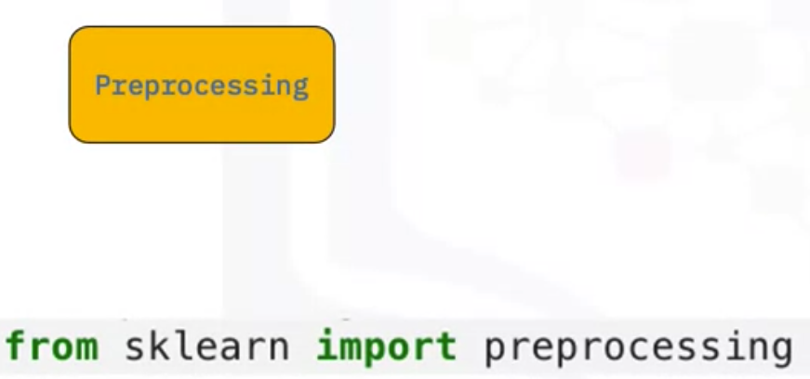
Predictive Analysis Overview
Preprocessing: standardize our data
Train_test_split: split our data into training and testing data
Predictive Analysis

Slide 5
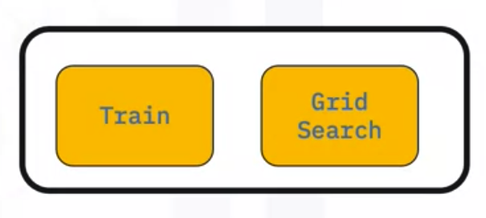
Predictive Analysis Overview
Train the model and perform Grid Search→ find the hyperparameters that allow a given algorithm to perform best.
Predictive Analysis

Slide 6
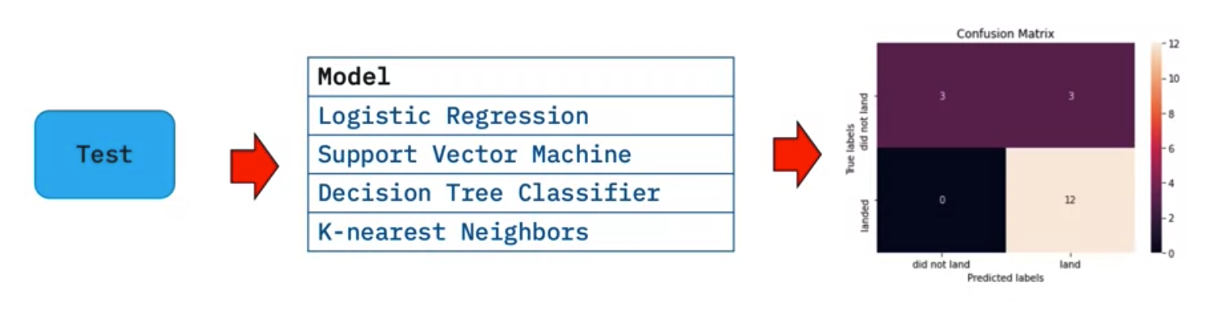
Predictive Analysis Overview
Hyperparameter values→ determine the model with the best accuracy using the training data.
Predictive Analysis

Slide 7
Predictive Analysis
Import and complete the following Jupyter notebook in IBM Watson Studio:
→ SpaceX_Machine Learning Prediction_Part_5.ipynb
DO BY YOUR SELF
Predictive Analysis
Notes:
https://cf-courses-data.s3.us.cloud-object-storage.appdomain.cloud/IBM-DS0321EN-SkillsNetwork/labs/module_4/SpaceX_Machine%20Learning%20Prediction_Part_5.ipynb

Slide 8
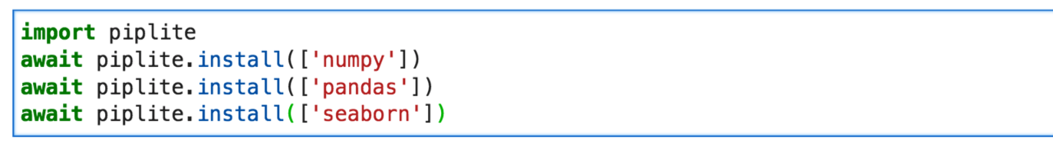
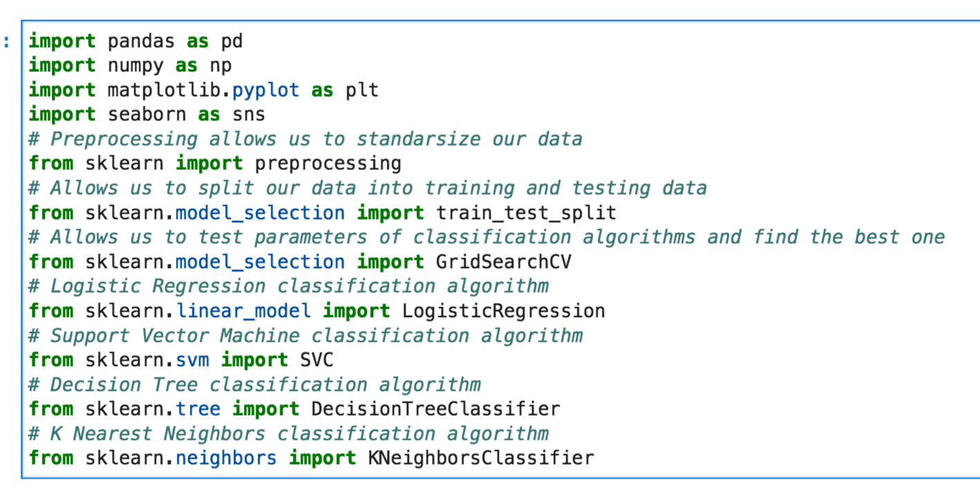
Setup Environment
Predictive Analysis

Slide 9
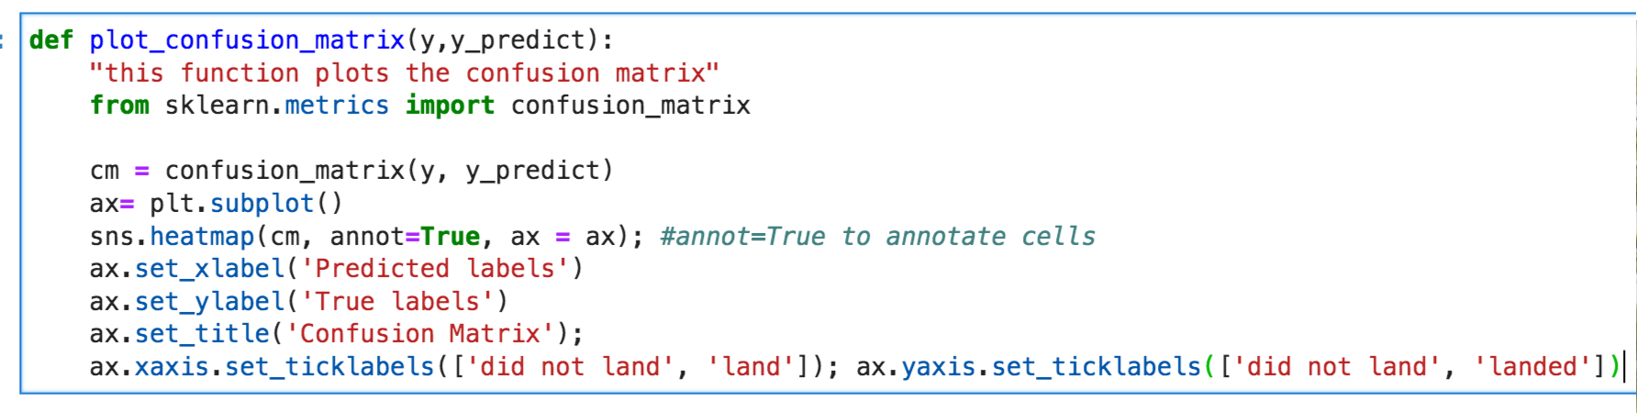
Setup Environment
Plot the confusion matrix
Predictive Analysis

Slide 10
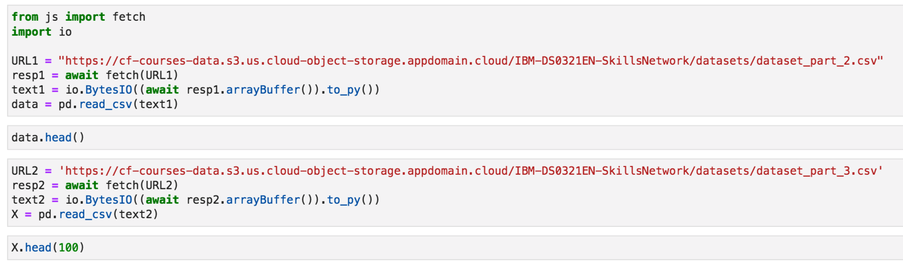
Setup Environment
Load the data
Predictive Analysis

Slide 11
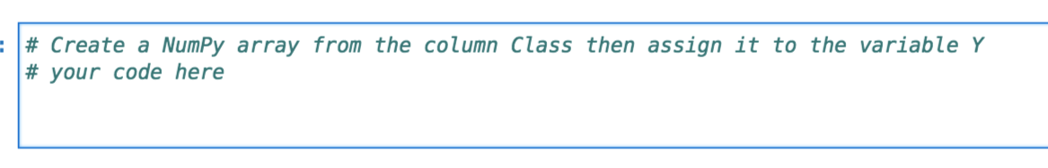
TASK1: Create a NumPy array
Create a NumPy array from the column Class in data
  Applying the method to_numpy() then assign it to the variable Y
Predictive Analysis

Slide 12
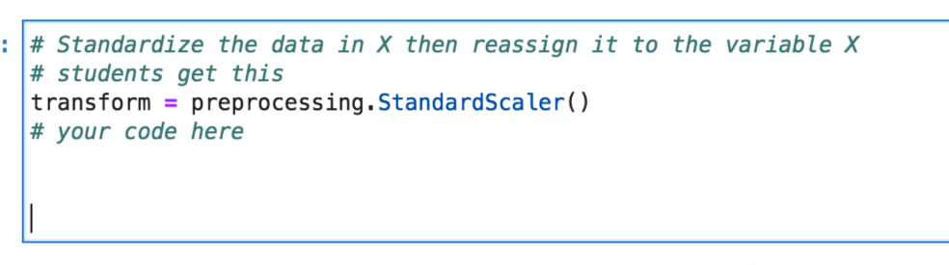
TASK2: Standardize the data
Standardize the data in X then reassign it to the variable X
Predictive Analysis

Slide 13
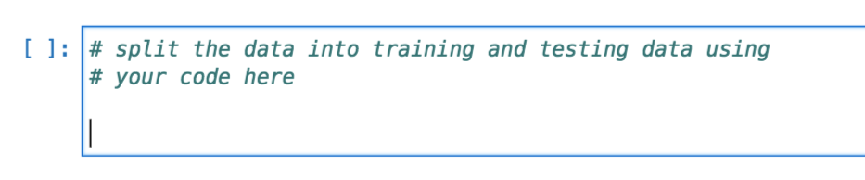
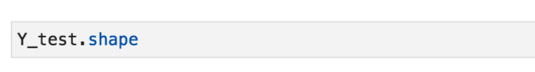
TASK3: create training and testing data
Use the function train_test_split to split the data X and Y into training and test data.
Set the parameter test_size to 0.2 and random_state to 2.
The training data and test data should be assigned to the following labels: X_train, X_test, Y_train, Y_test
Predictive Analysis

Slide 14
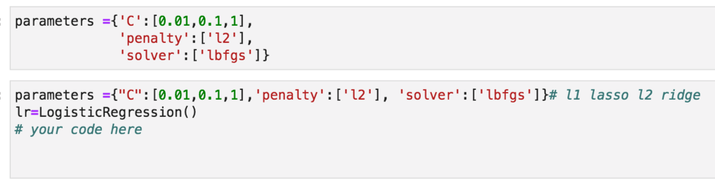
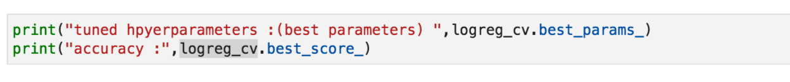
TASK4: find Hyperparameter
Create a logistic regression object then create a GridSearchCV object logreg_cv with cv = 10.
Fit the object to find the best parameters from the dictionary parameters
Predictive Analysis

Slide 15
Summary
Predictive Analysis Overview.
Standardize the data.
Split the data into training testing data.
Train different classification models.
Hyperparameter grid search.
Predictive Analysis

Slide 16
Q & A
Predictive Analysis

